Slide 1
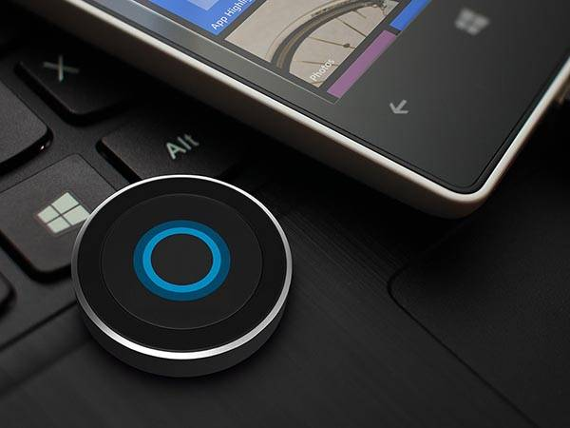
virtual assistant -Alexa

Slide 2
INTRODUCTION OF VIRTUAL ASSISTANT
A Virtual Assistant, also called AI assistant or digital assistant, is an application program that understands natural language voice commands and completes tasks for users
Typical tasks a virtual assistant might perform include scheduling appointments, making phone calls, making travel arrangements, and managing email accounts.
Virtual assistants are typically cloud-based programs that require internet-connected devices and/or applications to work.
Three such applications are Siri on Apple devices, Cortana on Microsoft Devices and Google Assistant ALEXA on Android devices.

Slide 3

Voice searches have dominated over text search. Web searches conducted via mobile devices have only just overtaken those carried out using a computer and the analysts are already predicting that 50% of searches will be via voice by 2020.
Virtual assistants are turning out to be smarter than ever. Allow your intelligent assistant to make email work for you. Detect intent, pick out important information, automate processes, and deliver personalized responses

Slide 4


Slide 5

Benefits OF having a VIRTUAL ASSISTANT
A virtual assistant makes your life easier.
Time the most important asset of everyone and it saves most of it.
Virtual assistant gives you more free time for your personal life.
You’ll Have Unlimited Earning Potential
Performs administrations works
Reduces human work

Slide 6
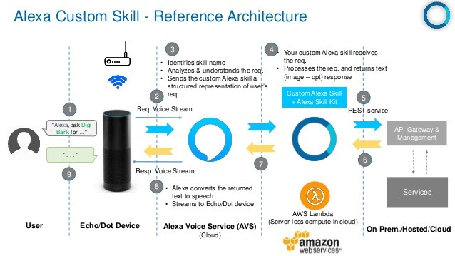

Slide 7

Project management
Presentation
Project structure
Flow of our project
Development
Deployment
Testing and Implementation

Slide 8
VIRTUAL ASSISTANT
PROCESS THE RESULT FROM THE BROWSER
PERFORM THE TASK
USER

Slide 9
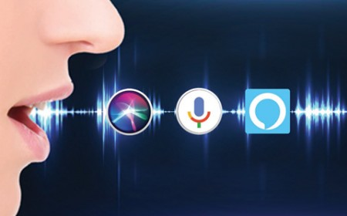
Virtual assistant performs
Speech recognition
Plays your desired song
Converts voice to text
Tells time and date whenever we ask
Can extract information from Wikipedia
Can respond to many voice commands

Slide 10
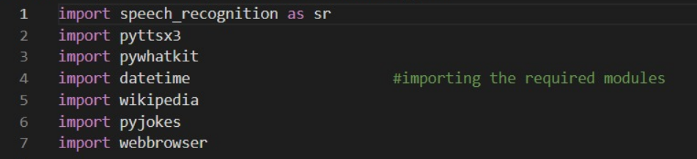
Coding part
“Installing the packages required”
“Importing the required modules”
We use the import function to import the required modules , The following module which have been imported has the various roles to play.
From the following modules we have 2 (Two) most important modules:-
Speech recognition – This module is used to get the voice as the input microphone.
Pyttsx3 – This module is used to convert text-to-speech conversion works offline , and is compatible with both python (2 and 3 version).

Slide 11
We used the following libraries or modules in our project -
1. Speech Recognition (To install the module ‘pip install speech recognition’)
2. Pyttsx3 (To install the module ‘pip install Pyttsx3’)
3. Pywhatkit (To install the module ‘pip install Pywhatkit’)
4. Pyjokes (To install the module ‘pip install Pyjokes’)
5. Datetime (To install the module ‘pip install Datetime’)
6. Wikipedia (To install the module ‘pip install Wikipedia’)

Slide 12
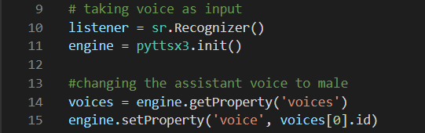
This part of code is used to take user voice as input and convert it into text format and stores. The other part i.e the ‘getProperty’ part changes the male voice to the female voice

Slide 13

Giving voice output
The ‘talk’ function is used to get the output in audio format and after finishing the task it waits for the next insturction to be given by the user.

Slide 14
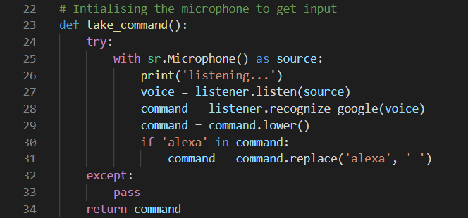
The ‘take_command’ function is used to initialize the microphone to listen the user voice and convert the voice to text by using the ‘listener’ variable which is declared already for the convertion.
The ‘if’ part is used to make the virtual assistant to get the user voice as input until or unless its name is called (in this case it is “Alexa”).

Slide 15
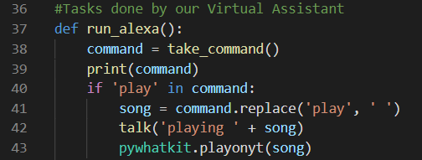
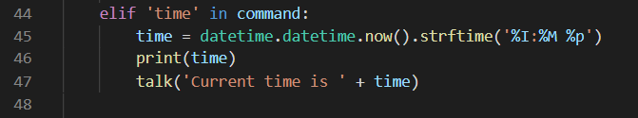
When user ask the virtual assistant to play the song it recognizes the ‘ play ’ word and goto Youtube , search for the song .
When user asks the virtual assistant for the time this part of the code recognize the ‘ time ’ word and gets the exact current time and gives the output to the user.

Slide 16
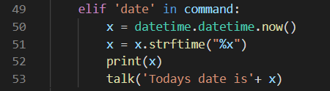
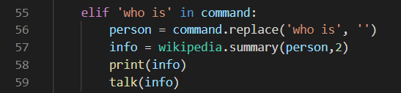
When user asks the virtual assistant for the date this part of the code recognize the ‘ date ’ word and gets the exact current date and gives the output to the user.
When user ask the virtual assistant to search about a person (eg: who is Narendra modi) it recognizes the word ‘ who is ’ and search for the information about the person in wikipedia and speaks 2 sentences about him.

Slide 17
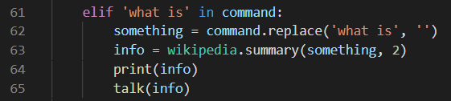
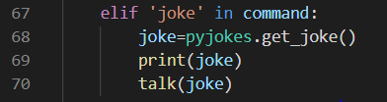
When user ask the virtual assistant to search about something (eg: what is virus) it recognizes the word ‘ what is ’ and search for the information about the topic in wikipedia and speaks 2 sentences about it .
When user asks for a joke it recognize the word ‘ joke ’ and says a random joke by searching it in the browser.

Slide 18
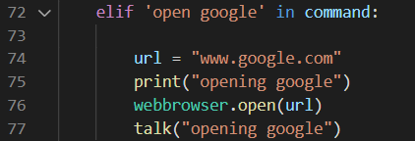
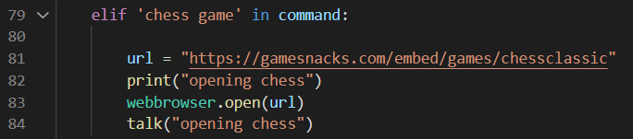
When user asks to open google it recognize the word ‘open google’ and says opening google then opens the google.
When user asks for chess game it recognize the word ‘ chess game’ it says opening chess and opens chess game

Slide 19
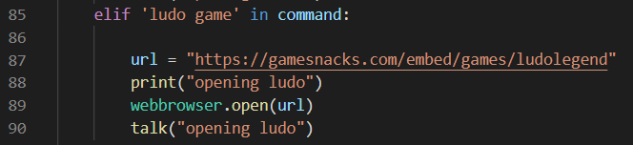
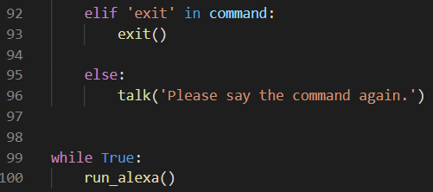
When user asks for ludo game it recognize the word ‘ludo game’ it says opening ludo and opens ludo game.

Slide 20
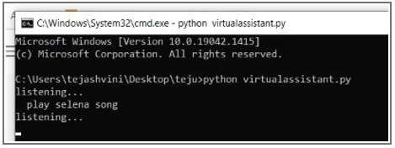
OUTPUT
When user ask the virtual assistant to play a song
eg:- “alexa play selena song”
It opens the youtube and play the song.

Slide 21
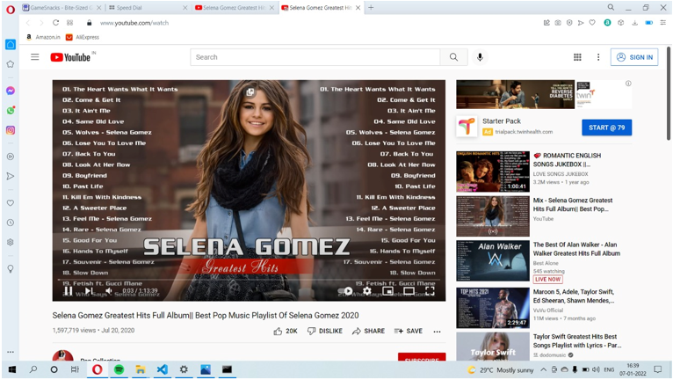

Slide 22

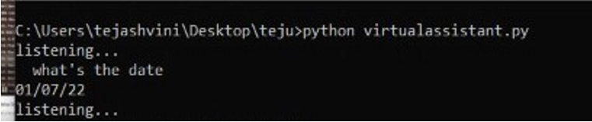
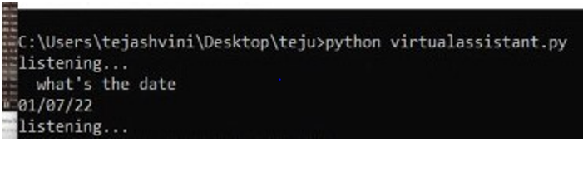
When user asks the time it gives the audio output and show the current time.
When user asks for the date it shows and also gives an audio output of it.

Slide 23

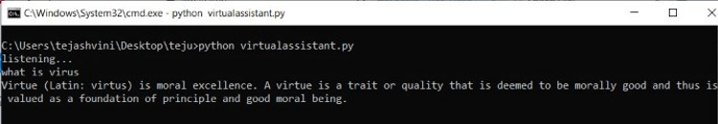
When user asks the assistant say a joke it goes to the web browser, select a random joke and gives the result in audio format.
When user asks for something like “what is virus” it goes to Wikipedia , search about it and says 2 lines about it .

Slide 24
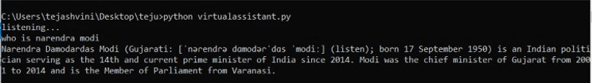
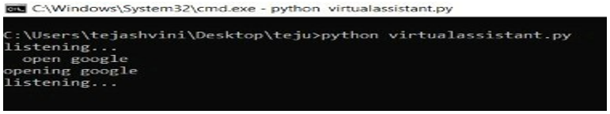
When user asks about a person like “who is Narendra modi” it goes to wikipedia , search about the person and says 2 lines about him .
When users asks “open google” it says opening google and opens google.

Slide 25
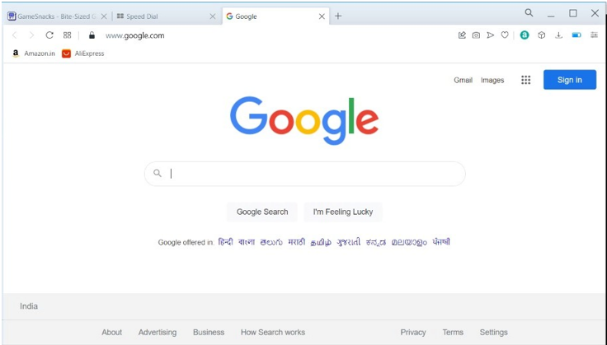

Slide 26
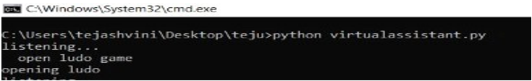
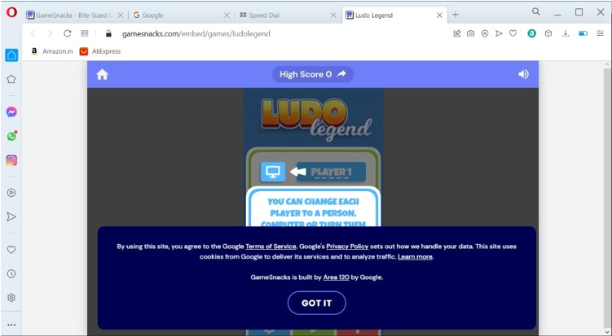
When the user asks “open ludo” it says opening ludo and opens ludo game in the browser.

Slide 27
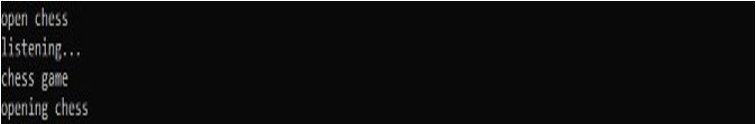
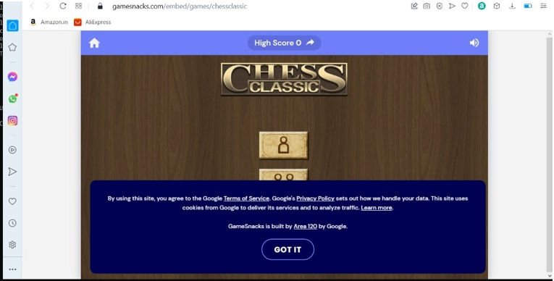
When the user asks “open chess” it says opening chess and opens game in the web browser.

Slide 28
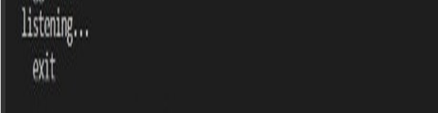
When we don’t want to use the use the assistant and the user says exit it stops the program and exit it.
And here is the end of the project

Slide 29
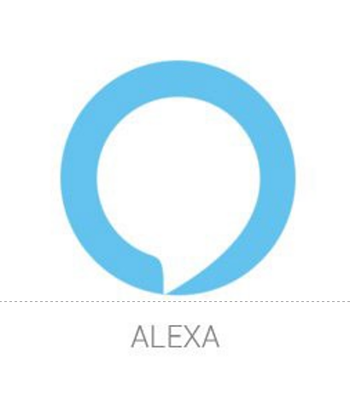
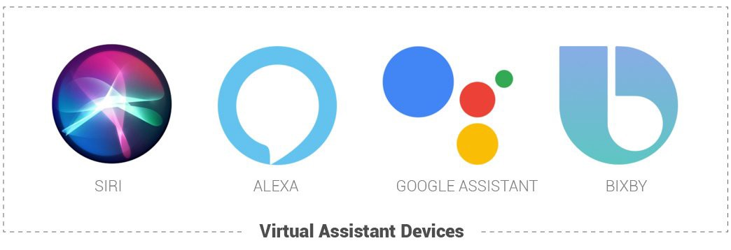
THANK YOU
THANK YOU

